Slide 1
What is Docker?

Slide 2
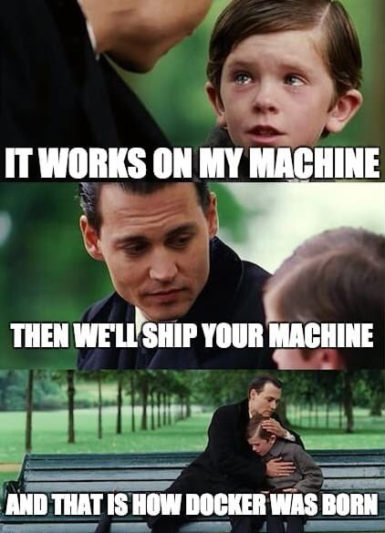

Slide 3
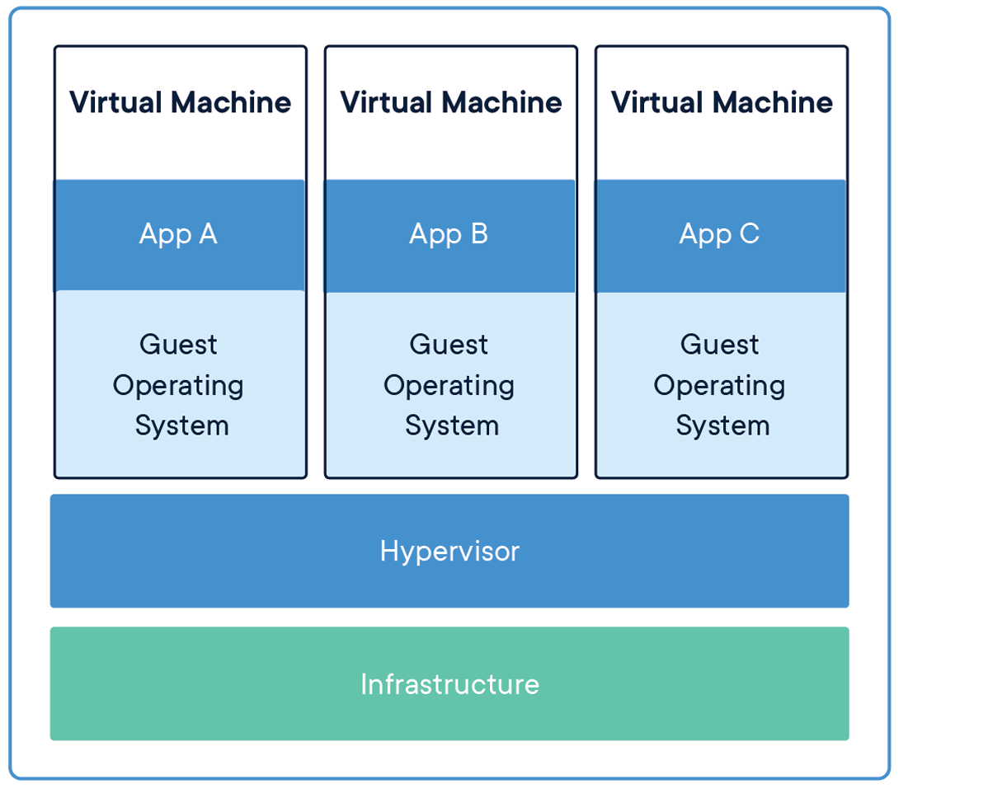

Slide 4
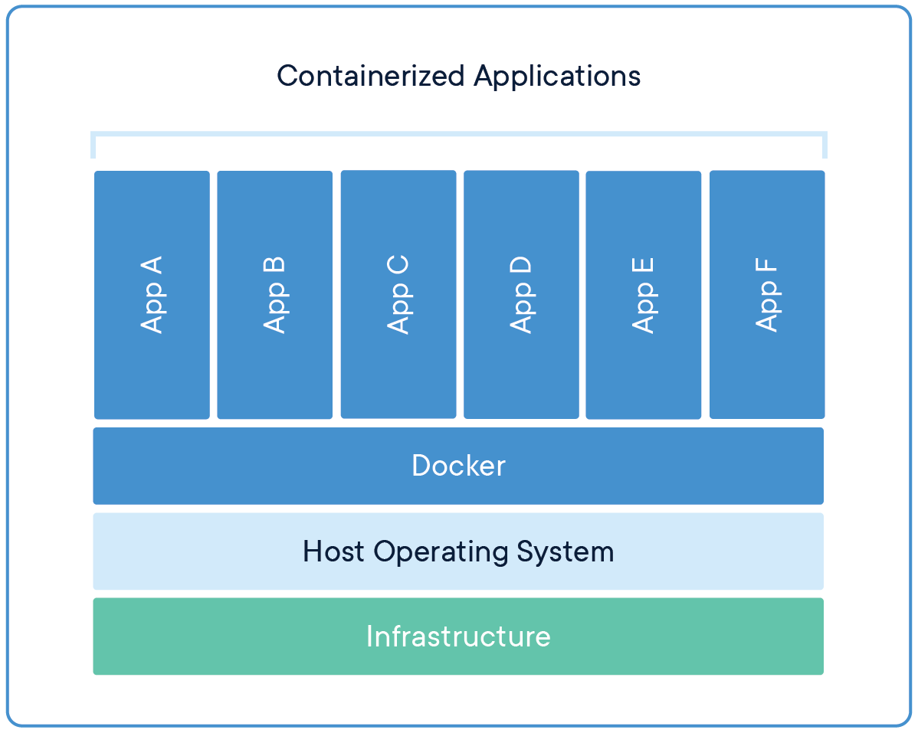

Slide 5
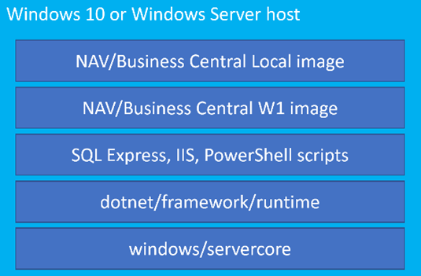

Slide 6
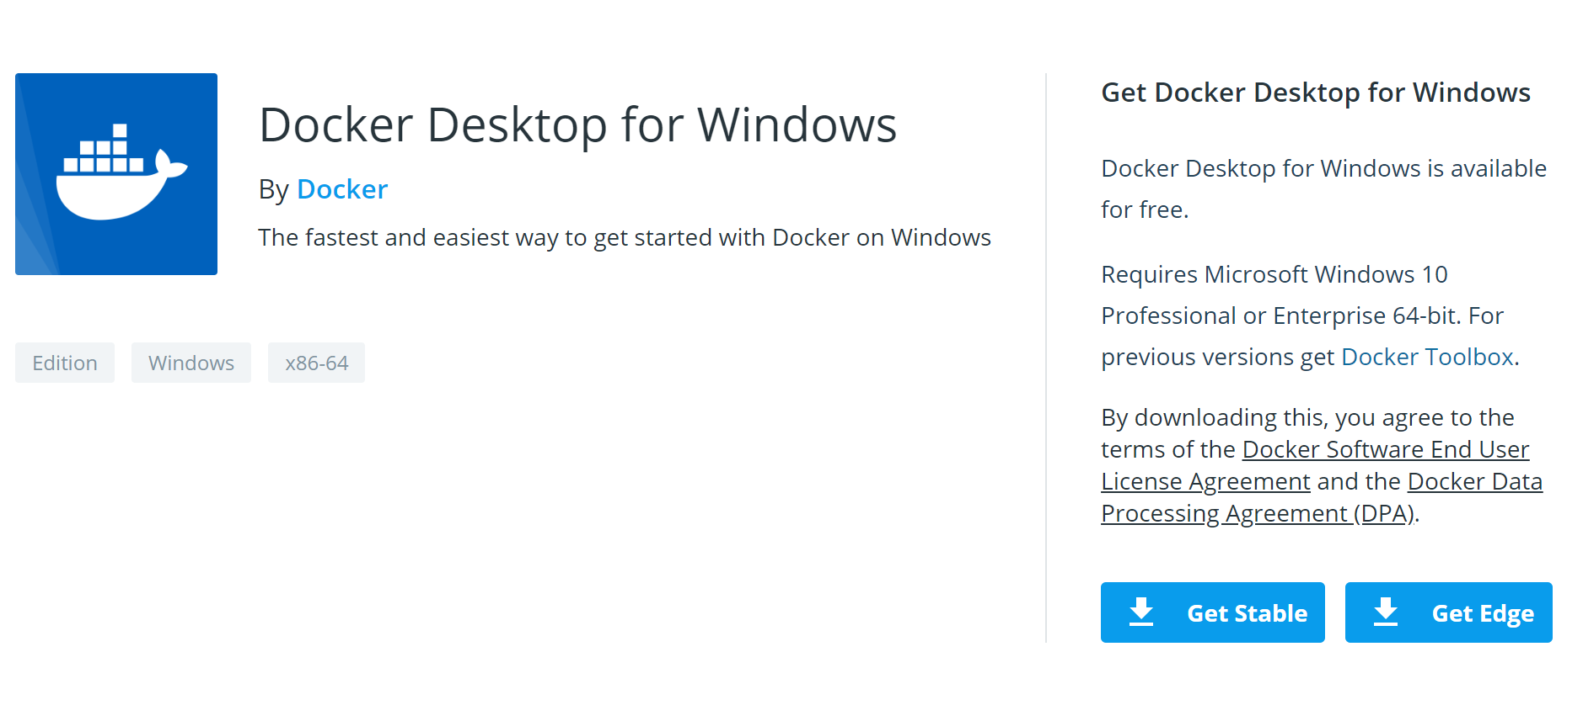

Slide 7
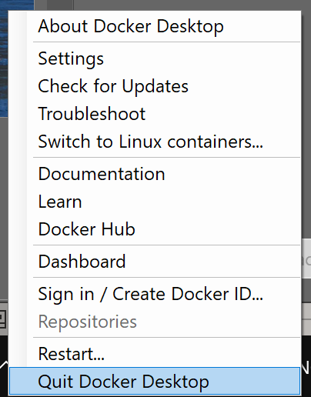

Slide 8
BCContainerHelper/ NAVContainerHelper

Slide 9
Let’s make a container!

